Slide 1
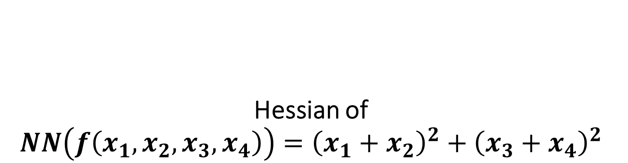
Hessian of $$NN\left(f\left(x_{1},x_{2},x_{3},x_{4}\right)\right)={\left(x_{1}+x_{2}\right)}^{2}+{\left(x_{3}+x_{4}\right)}^{2}$$

Slide 2
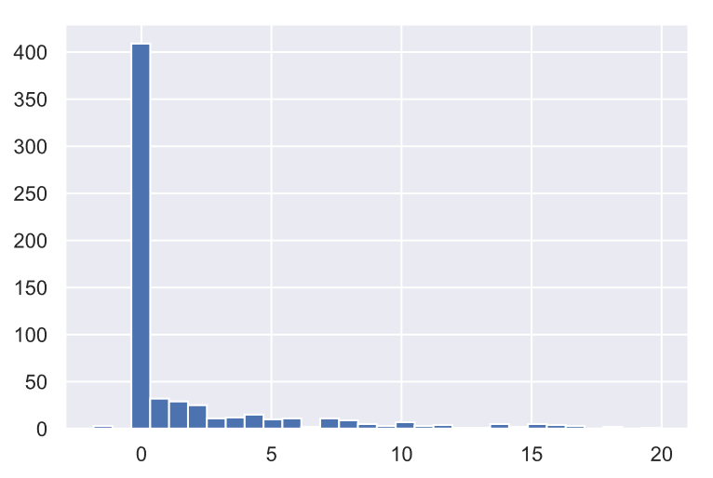

$$\frac{∂NN^{2}}{∂x_{1}∂x_{1}}$$

Slide 3
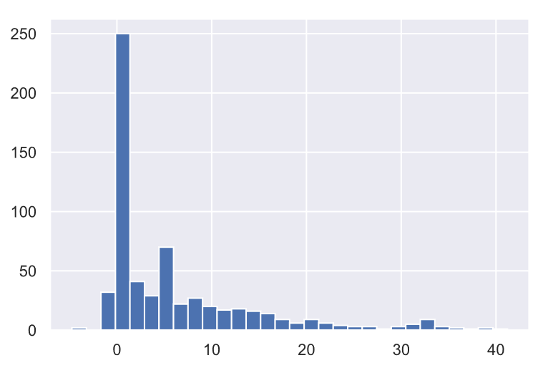

$$\frac{∂NN^{2}}{∂x_{1}∂x_{2}}$$

Slide 4
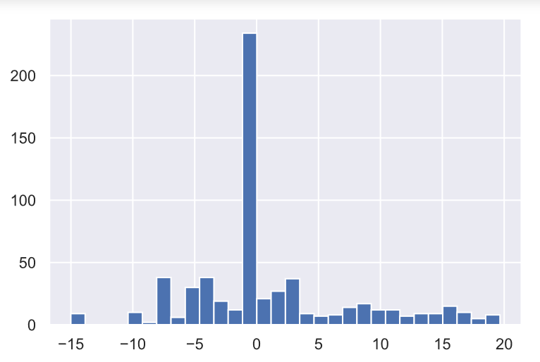

$$\frac{∂NN^{2}}{∂x_{1}∂x_{3}}$$

Slide 5
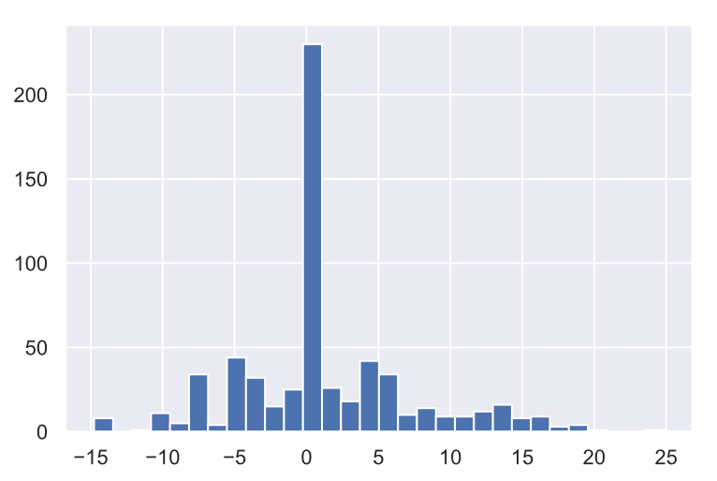

$$\frac{∂NN^{2}}{∂x_{1}∂x_{4}}$$

Slide 6
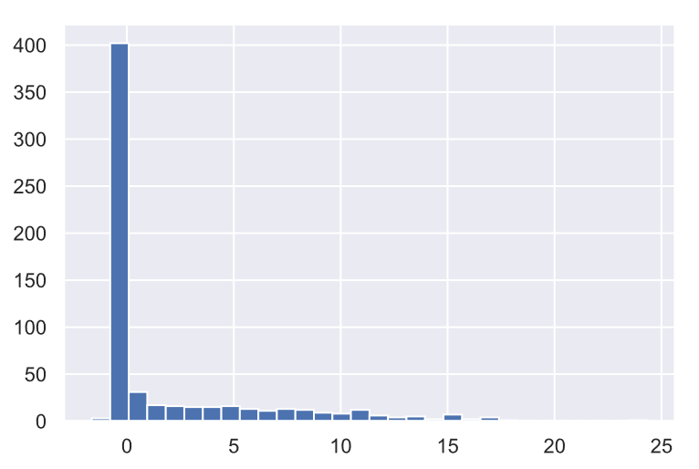

$$\frac{∂NN^{2}}{∂x_{2}∂x_{2}}$$

Slide 7
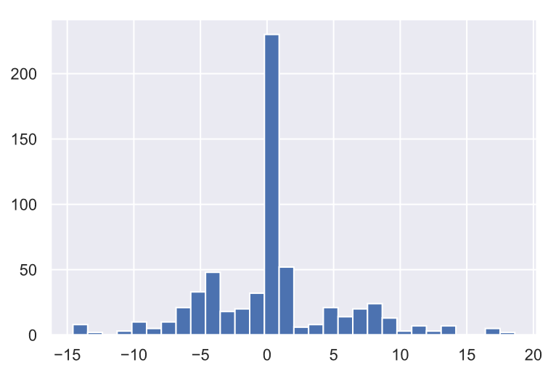

$$\frac{∂NN^{2}}{∂x_{2}∂x_{3}}$$

Slide 8
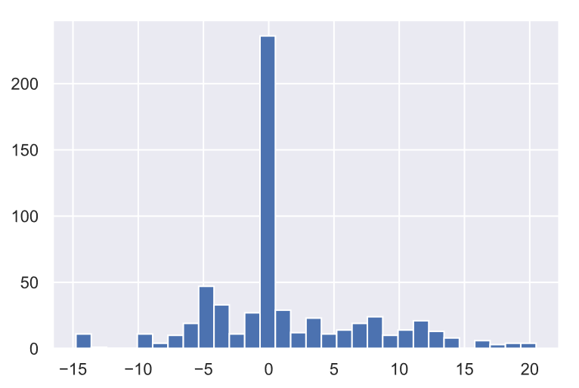

$$\frac{∂NN^{2}}{∂x_{2}∂x_{4}}$$

Slide 9
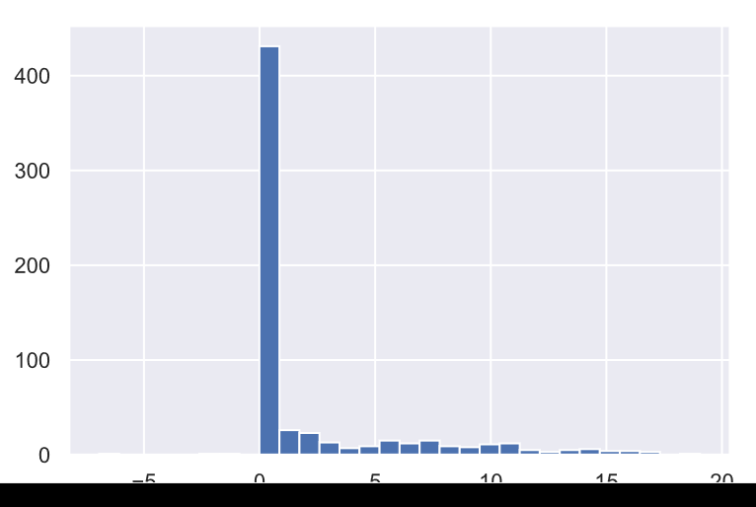

$$\frac{∂NN^{2}}{∂x_{3}∂x_{3}}$$

Slide 10
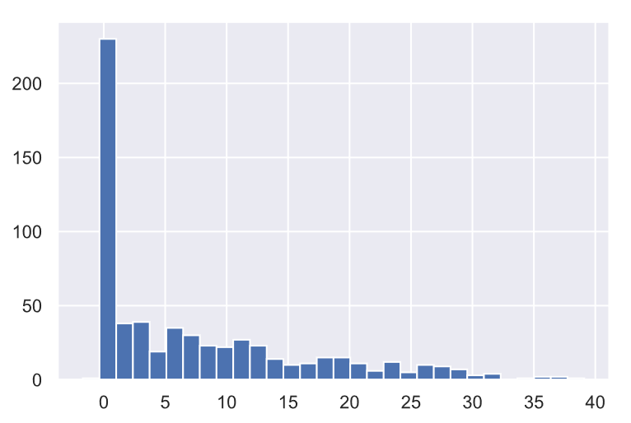

$$\frac{∂NN^{2}}{∂x_{3}∂x_{4}}$$

Slide 11
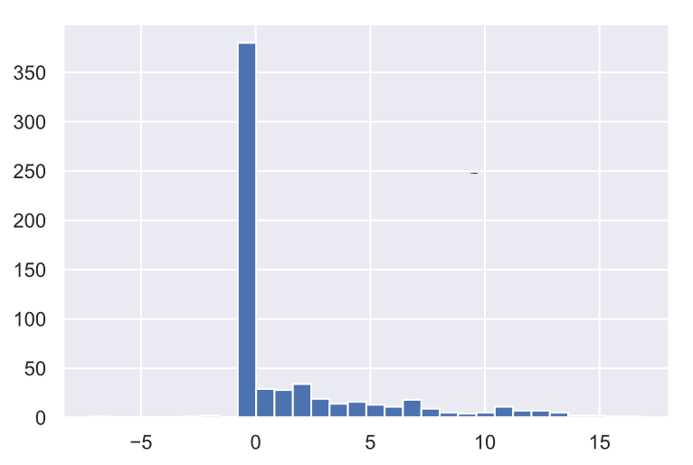

$$\frac{∂NN^{2}}{∂x_{4}∂x_{4}}$$

